Slide 1
FEAF/TBM Alignment Tool
Quick Painless Automated
Developed by Patrick Stingley
Bureau of Land Management
April 25, 2021
Patrick Stingley
Pstingley@BLM.gov
(202) 815-3550

Slide 2
Situation
The Federal Enterprise Architecture Framework hasn’t been updated in a decade but agencies still have a significant investment in it, along with a push for TBM in federal government.
The FEAF/TBM Alignment Tool mitigates this dual reporting requirement
Patrick Stingley
Pstingley@BLM.gov
(202) 815-3550
Notes:
While there is a push for TBM in the government the Federal Enterprise Architecture Framework (FEAF) hasn’t been updated in a decade.
All Agencies have automated inventories which are sent to DHS/CDM.
Despite the FEAF being obsolescent, Agencies have a significant investment in it.
This tool was designed to leverage that.
Agencies now have an unfortunate dual-reporting requirement.
This tool mitigates that.

Slide 3
FEAF/TBM
Alignment Tool
An organization of 10,000 people has around 1.5M pieces of software on its network.
Too much for manual EA
Too big for Excel
The tool is two parts:
A Python program that sorts and counts the software and makes the data small enough for Excel
An Excel program that aligns the software with both the FEAF and TBM.
Works with other inventory tools, such as Belarc, SCCM etc
Patrick Stingley
Pstingley@BLM.gov
(202) 815-3550
Notes:
An organization of 10,000 people has around 1.6M pieces of software on its network.
Too much for manual EA
Too big for Excel
Average rate of change for 10k people is 200-300 new pieces of software per month.
The tool is two parts:
A Python program that sorts and counts the software and makes the data small enough for Excel
An Excel program that aligns the software with the FEAF and TBM.
The Python program was designed for non-programmers. Tested on many versions of Python from 2.7 to 3.9 It outputs a file that users cut and paste into the Excel spreadsheet. The entire process takes 4 min.
Works with other inventory tools, such as Belarc, SCCM etc. However:
Belarc and SCCM identify less than half of the products Big Fix does.
The product names are somewhat different but it will work with you to adjust to your agency’s needs.

Slide 4
FEAF/TBM Alignment Tool Partners
Through the work of the FTIM CoP and others in GSA’s Office of Government-wide Policy (OGP), a big thank you for working with me and with the TBM council in aligning the FEAF categories with TBM.
When we started TBM lacked about 40% of categories the Federal Government uses.
Patrick Stingley
Pstingley@BLM.gov
(202) 815-3550

Slide 5
Procedure
Get the data
1
Process the data
2
Paste the data
3
Patrick Stingley
Pstingley@BLM.gov
(202) 815-3550

Slide 6
File Location:
https://github.com/pstingley/Automated-Enterprise-Architecture
Patrick Stingley
Pstingley@BLM.gov
(202) 815-3550

Slide 7
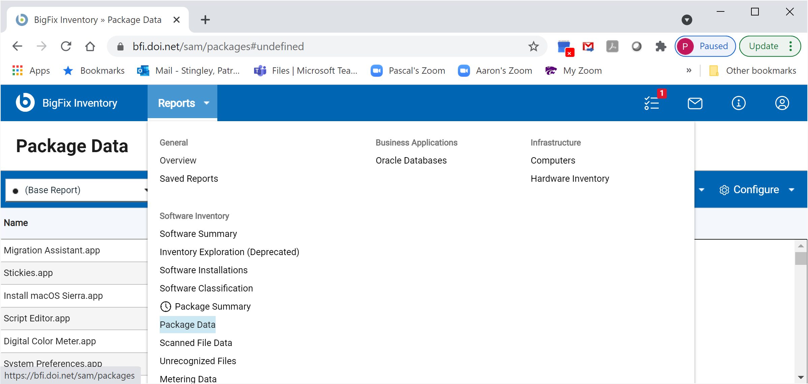
Step 1
Get the data (Choose Package Data)
Patrick Stingley
Pstingley@BLM.gov
(202) 815-3550
Notes:
Any tool that can provide the product name will work. Product name and version are preferred. The example is from BigFix, but inventory data from other tools can work.
In BigFix (BFI interface), go into Reports and select Package Data

Slide 8
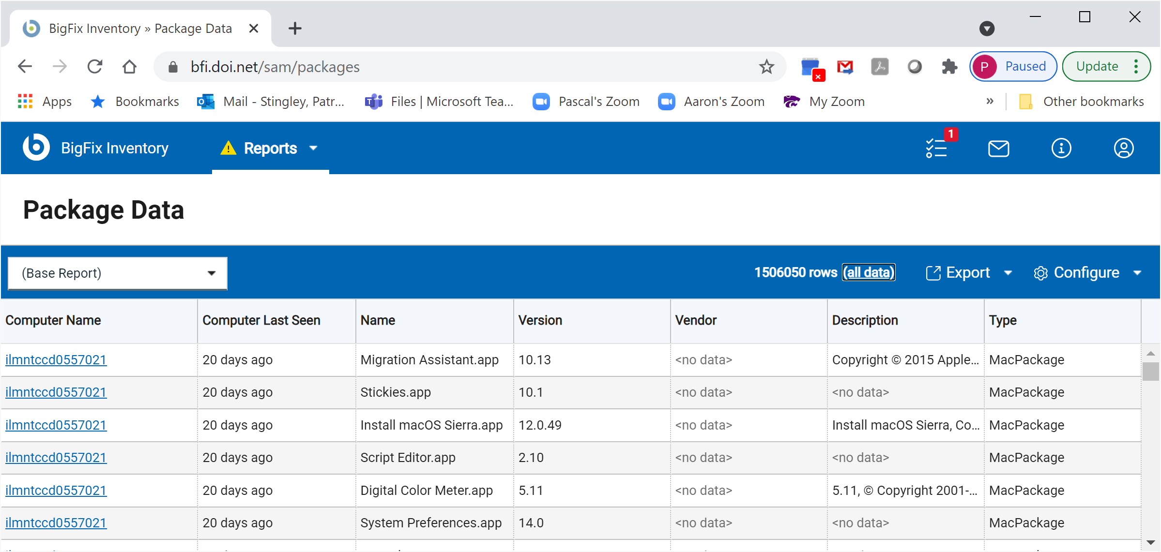
Step 1
Get the data (Choose “all_data” to modify the Report)
Patrick Stingley
Pstingley@BLM.gov
(202) 815-3550
Notes:
This is too much data, so go into (all data) to remove some of it.

Slide 9
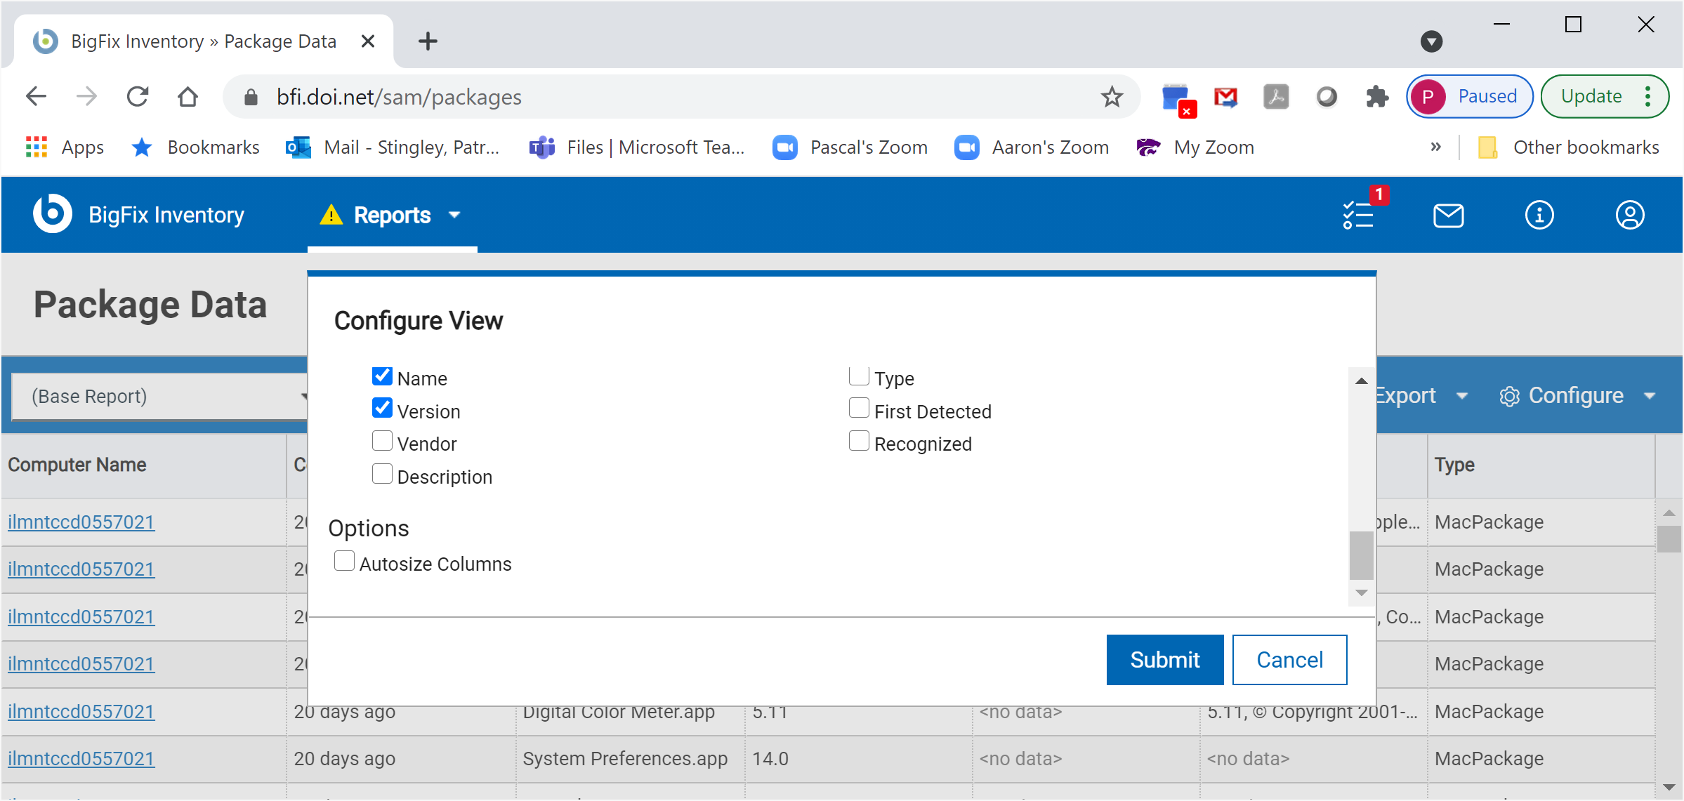
Step 1
Get the Data: (Keeping Product Name and Version.)
Patrick Stingley
Pstingley@BLM.gov
(202) 815-3550
Notes:
De-select everything except Name and Version

Slide 10
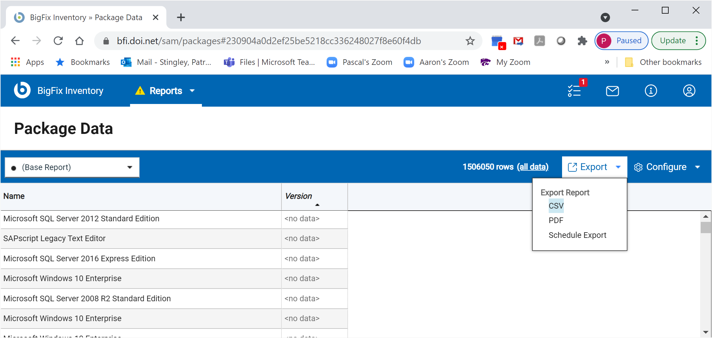
Step 1
Get the data (Export as .csv)
Patrick Stingley
Pstingley@BLM.gov
(202) 815-3550
Notes:
Export this report as a Comma Separated Value (.csv) file

Slide 11
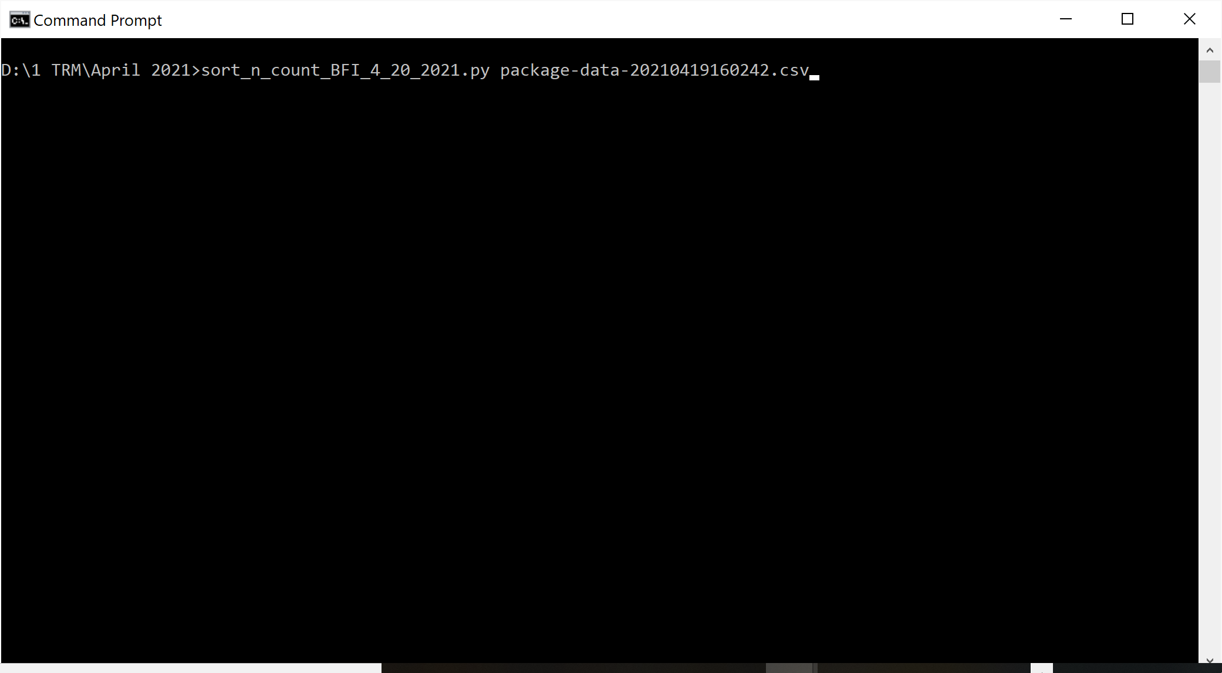
Step 2
Sort & Count the Data
This also makes it small enough for Excel
Patrick Stingley
Pstingley@BLM.gov
(202) 815-3550
Notes:
Open a command window.
Type:
Process_BFI_3_23_2021.py followed by the name of the .csv file you just created.
The name is “Process BFI” because it processes data from the BFI interface of BigFix. These should work with data from any inventory system, so long as they can produce a .csv file with the product and version for all software.
I have a program that can clean up data if yours needs to be cleaned first.

Slide 12
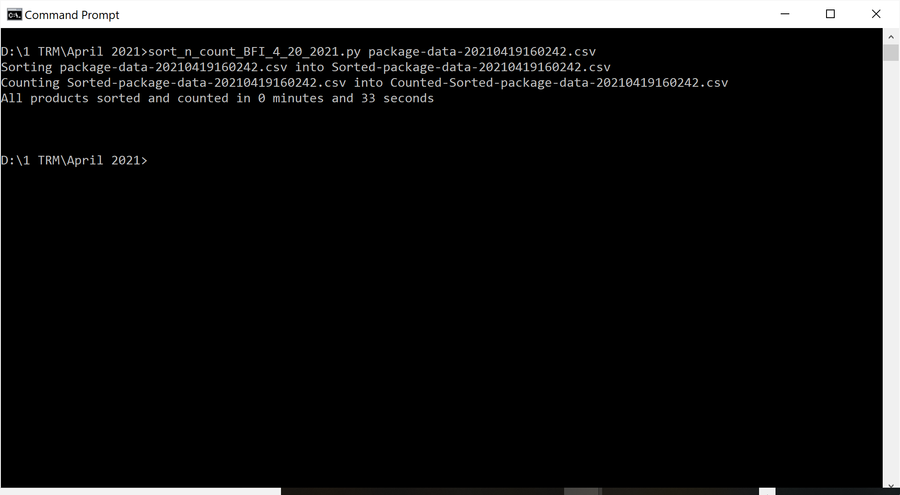
Step 2
Sorting and Counting took 33 Seconds
Patrick Stingley
Pstingley@BLM.gov
(202) 815-3550
Notes:
The program reports progress as it works:

Slide 13
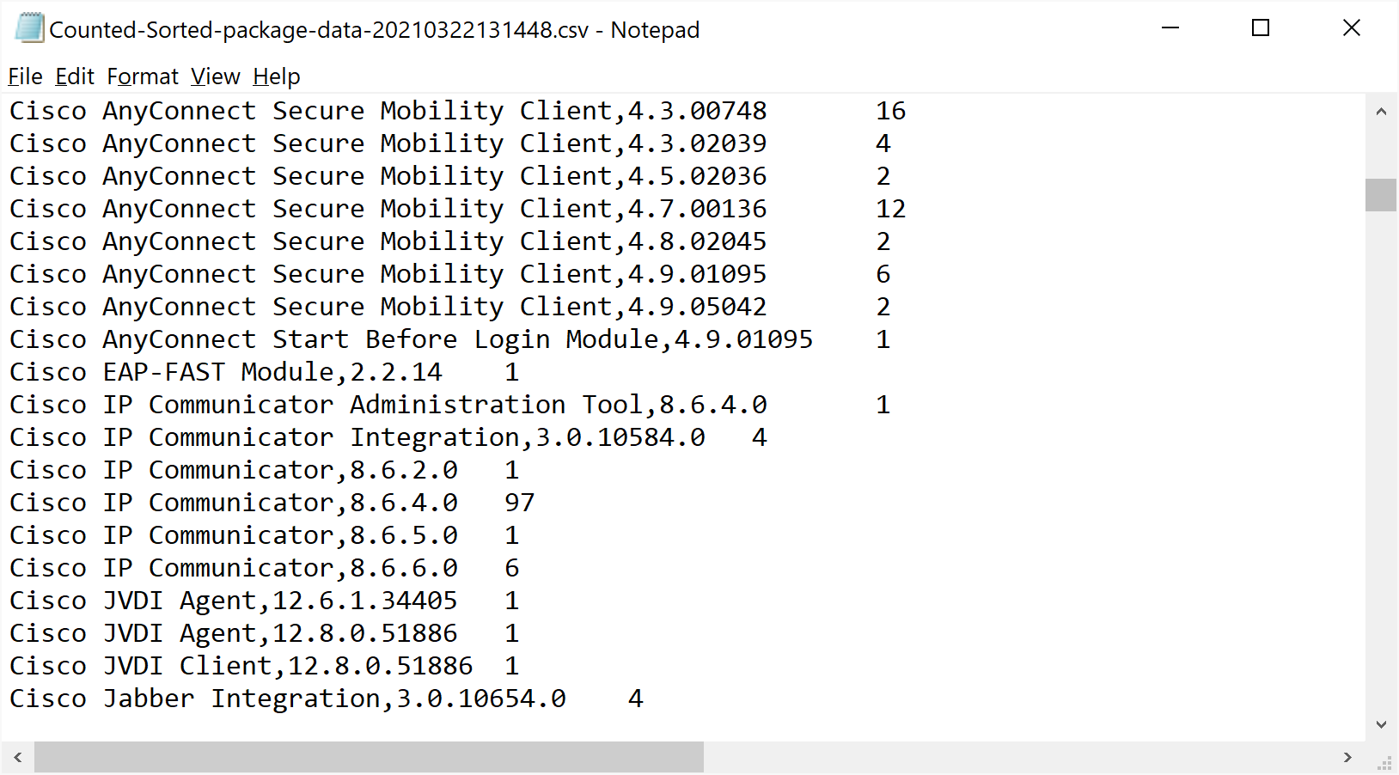
Step 2
Open the output file in Notepad
Patrick Stingley
Pstingley@BLM.gov
(202) 815-3550
Notes:
It will tell you the name of the text file it is creating. Open the output file with Notepad.

Slide 14
Step 3
Copy the Data <CTRL><a> then <CRL><c>
Patrick Stingley
Pstingley@BLM.gov
(202) 815-3550
Notes:
Select all (<CTRL>+<A>) and Copy (<CTRL>+c), then paste into the Products tab in the spreadsheet.

Slide 15
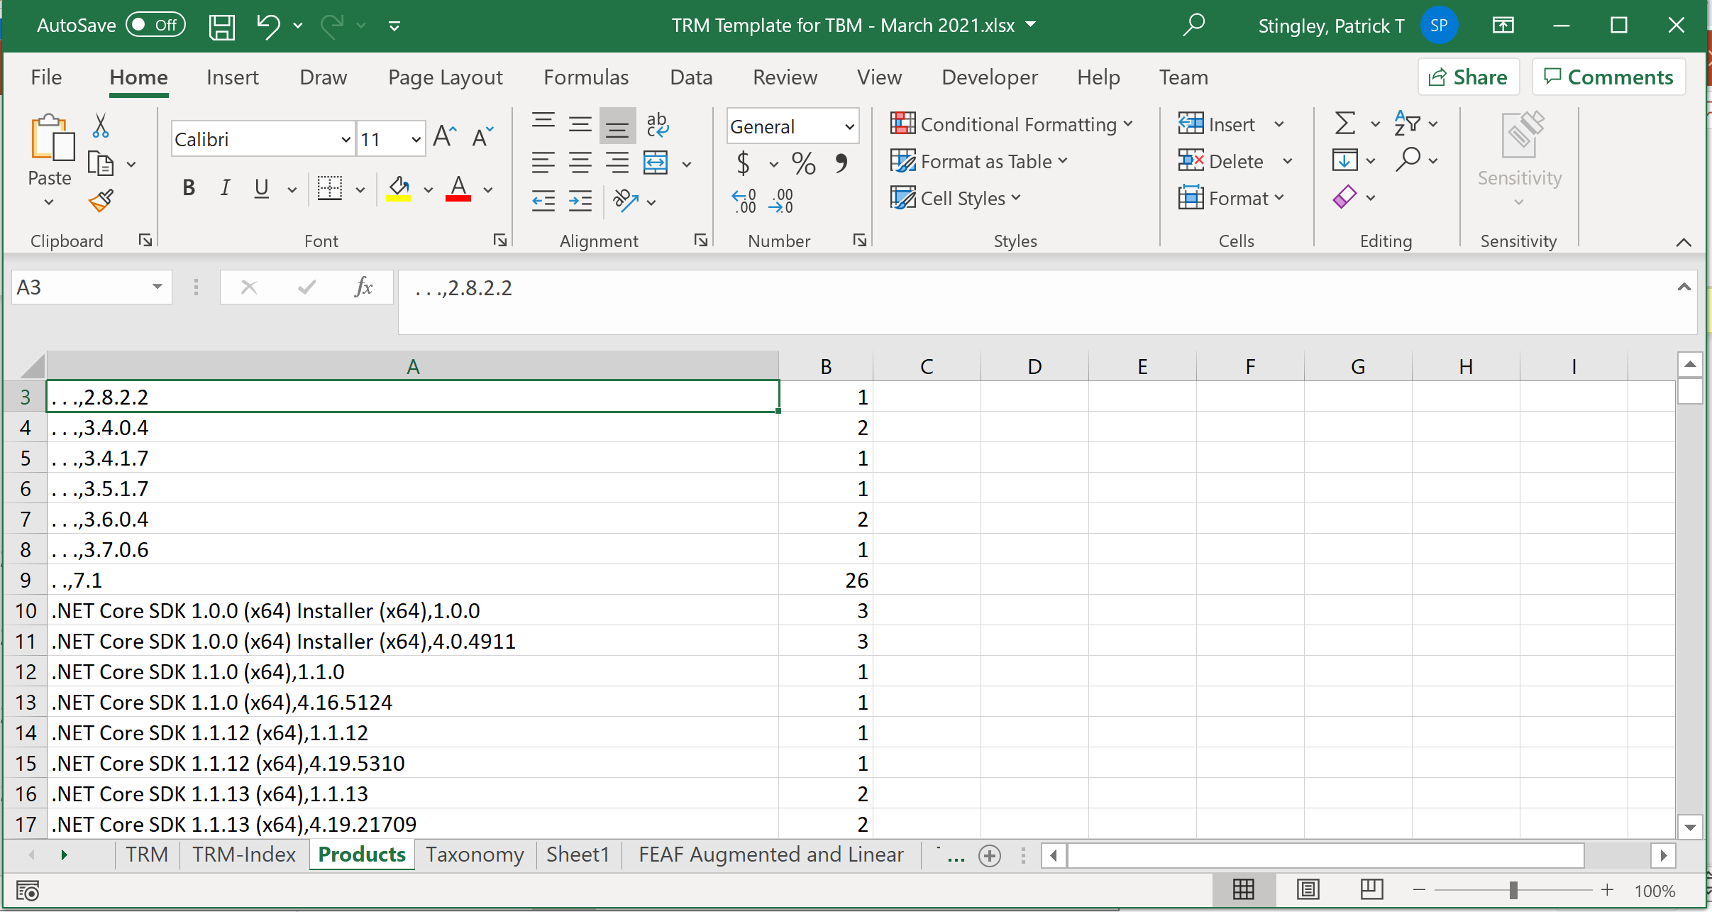
Step 3
Paste the Data over the Products Sheet
Patrick Stingley
Pstingley@BLM.gov
(202) 815-3550
Notes:
Now, you have a counted inventory of your software

Slide 16
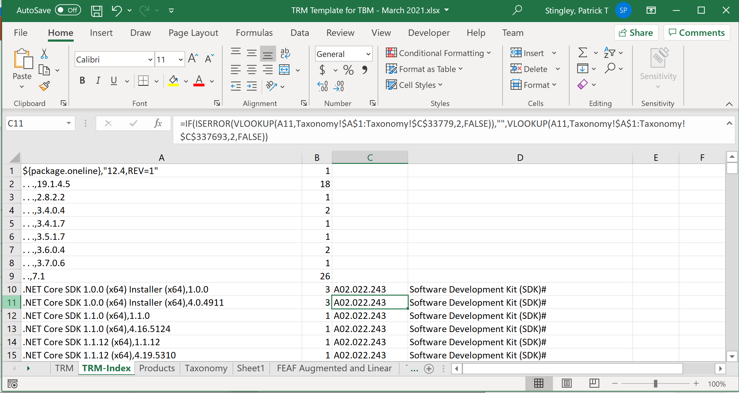
Step 3
The macros will update the other sheets
Patrick Stingley
Pstingley@BLM.gov
(202) 815-3550
Notes:
Now, the macros do all the work.
(You’re done!)

Slide 17
Step 3
Copy the TRM-Index and Paste Over the TRM Sheet as literal values (This allows the TRM to be sorted)
Patrick Stingley
Pstingley@BLM.gov
(202) 815-3550
Notes:
The macros match the products you pasted into the Products tab against the alignment of these products with the FEAF, located in the Taxonomy tab.

Slide 18
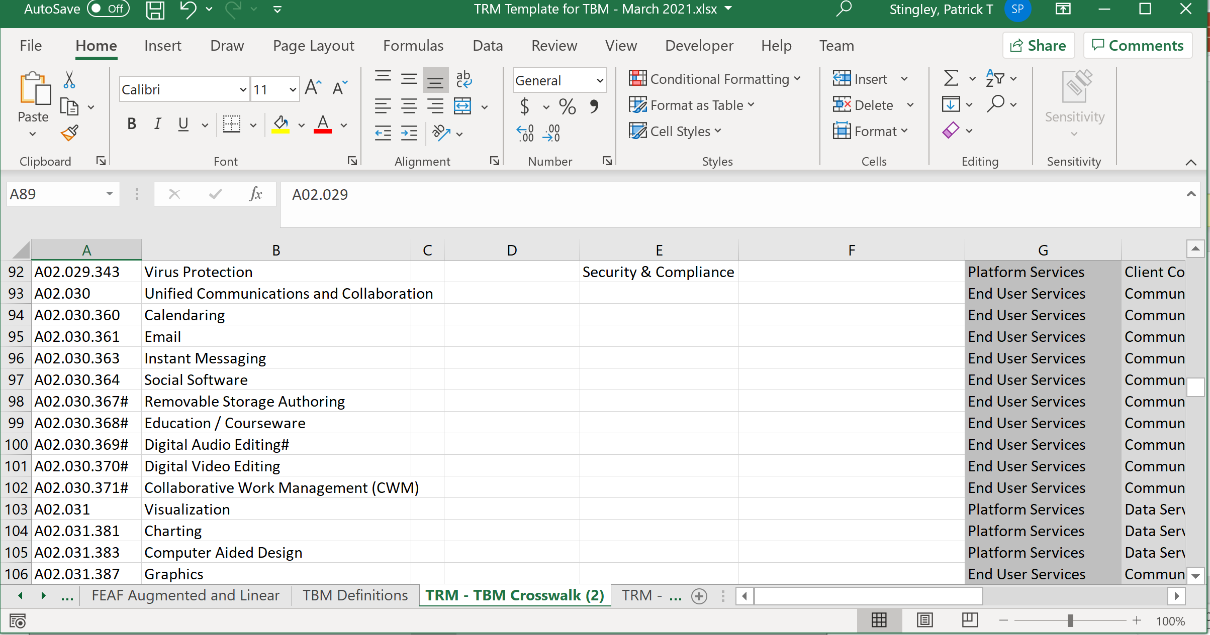
Step 3
“TRM – TBM Crosswalk” Correlates the Models
Patrick Stingley
Pstingley@BLM.gov
(202) 815-3550
Notes:
The TRM – TBM Crosswalk tab contains the mapping between the FEAF categories and the TBM categories.

Slide 19
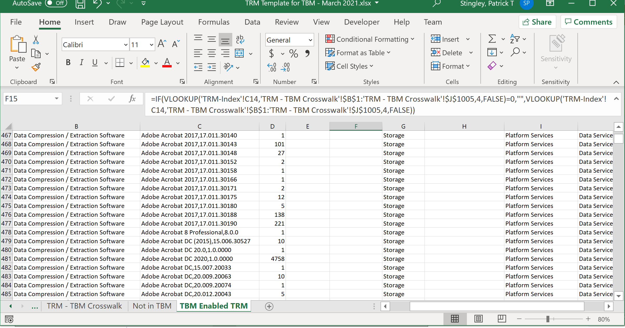
Step 3
Resulting in a TBM Enabled TRM
Patrick Stingley
Pstingley@BLM.gov
(202) 815-3550
Notes:
Again, the macros do their work and all of the products, with their FEAF categories and counts are now aligned with the TBM categories!

Slide 20
Demo
Patrick Stingley
Pstingley@BLM.gov
(202) 815-3550

Slide 21
Questions?
Patrick Stingley
Pstingley@BLM.gov
(202) 815-3550

Slide 22

Contact Information: Patrick Stingley
Pstingley@blm.gov
(202) 815-3550
Patrick Stingley
Pstingley@BLM.gov
(202) 815-3550

